Slide 1
Scaling Distributed Machine Learning with the Parameter Server
STRADS: A Distributed Framework for Scheduled Model Parallel Machine Learning
Mu Li∗‡, David G. Andersen∗ , Jun Woo Park∗ , Alexander J. Smola∗†, Amr Ahmed† , Vanja Josifovski† , James Long† , Eugene J. Shekita† , Bor-Yiing Su†
Jin Kyu Kim1 Qirong Ho2 Seunghak Lee1 Xun Zheng1 Wei Dai1 Garth A. Gibson1 Eric P. Xing
By Matthew, Jiho and Zineb

Slide 2
Scaling Distributed Machine Learning with the Parameter Server

Slide 3
Overview
Background and Motivation
Architecture
Implementation
Results

Slide 4
Background and Motivation
There is a lot of “big” data:
Texts
Images
Voices
Videos
User activities
Notes:
This represents a huge amount of training data
In machine learning and deep learning, distributed optimizations is a necessity because a single machine cannot solve the rapid growth in data and parameters
I will explain this with an example

Slide 5

Background and Motivation
Ad links in Google search
Good prediction => more $$$
Notes:
Everyone has done this before, if I want to book a hotel room with a jacuzzi I perform a query
On the top links, there are few ads posted by google, which means that google will get paid if you click on the ad
But not all ads are of interest for everybody.
That is why there a need to process a huge amount of training data in order to come up with the best predition and generate the highest revenue for google
There is a direct link between the size of training data and google revenue, the more training data they have, the more benefits they make because they are able to predict your interesert more accruatly regardless of the degree of your activity

Slide 6
Background and Motivation
Machine Learning is concerned with systems that can learn from data
Training data
ML system
Model (Key,Value)
Raw data
(user queries)
Training Data is Large – 1TB to 1PB
Complex Models with Billions and Trillions of Parameters
Parameters are shared globally among worker nodes : Network cost, ML Jobs barriers and Fault tolerance
Challenges
Notes:
This is how machine learning algorithms works
The number of training data can reach 1TB to 1 PB and the parameters during training can reach 10 to the power of 9 to 10 to the power of 12
And usually the parameters needs to be accessed freq. by all workers which brings many challenges and many problems
Accessing them incurs large Network costs
Sequential ML jobs require barriers and hurt performance by blocking
Fault Tolerance is required as these jobs run in a cloud environment where machines are unreliable and jobs can crush

Slide 7
Challenges
Training Data is Large – 1TB to 1PB
Complex Models with Billions and Trillions of Parameters
Parameters are shared globally among worker nodes:
Accessing them incurs large Network costs
Sequential ML jobs require barriers and hurt performance by blocking
Fault Tolerance is required as these jobs run in a cloud environment where machines are unreliable and jobs can crush
Notes:
Reading and updating parameters shared between different workers nodes
Efficient mechanism for aggregating and synchronizing model parameters between workers
Communication : overhead of sending key value pairs high (for small values)
Represent parameter as mathematical object and update part of the object (row of a matrix for example)
Batch communication of updates + processing on the parameter server
Fault tolerance is critical
Replication of parameters between Servers

Slide 8
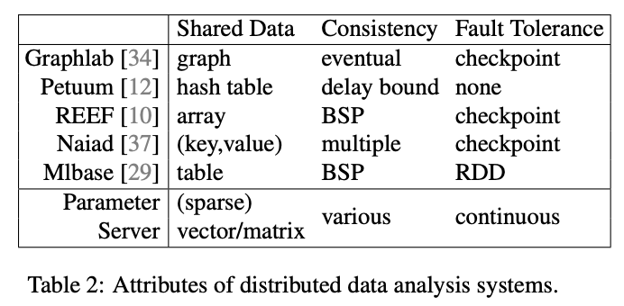
Related Work
Amazon, Baidu, Facebook, Google, Microsoft, Yahoo
Open source projects:
YahooLDA, Petuum, Graphlab
Lack of Flexibility and Performance
NO FAULT TOLERANCE
Notes:
There are already some parameter servers,
1st, second generation but they all lacked flexibility and performance for large scaled clusters
And more importantly, the fault tolerance feature
If we compare the other algorithms, param server offers the greater degree of flexibility in consistency, and the only one offering continuous fault tolerance
First generation:
Lack of flexibility and performance
Memcached (key,value)as sunchronizing mechanism
Yahoo LDA improved approach with distributed operations like get set and update
Second generation:
Improved yahoo LDA with bounded delay model
But further limited the worker threading model

Slide 9
Related works
First generation parameter server
Memcached (key,value)
YahooLDA (set, get, update)
Second generation parameter server
Bounded delay model
Limited the worker threading model
Third-generation parameter server
Notes:
Explain what is bounded delay and how Memcached and yahooLDA is operating
Limitations
Why changes from one to another
What improvements has been made
Find examples!!!!

Slide 10
Related works
Third-generation parameter server?
General distributed systems
Each iteration is forced to synchronize
Works well for few nodes
Slow performance for large-scale clusters

Slide 11
Key Features of Parameter Server
Efficient Communication
Flexible Consistency Models
Elastic Scalability
Fault Tolerance and Durability
Ease of Use
Notes:
asynchronous communication model (does not block computation) no need to wait for another machine to perform an iteration unless necessary (if we need the result from the previous iteration) This reduces the delay and makes some optimizations in machine learning tasks to reduce network traffic
Algorithm designer can balance algorithmic convergence and system efficiency based on its own situation
It uses a distributed hash table that allows New server nodes to be added at any time without the need to restarting framework
Node failures can happen anytime, Quick Recovery and Repair is less than 1sc and does not interrupt current computation
easy for users to write programs: the global shared parameters can be represented in various forms vectors, matrices or corresponding sparse space types which greatly facilitate the development in machine learning algorithms and the linear algebra data types provide high performance multi-threaded libraries which makes it easier to use

Slide 12
Architecture

Slide 13
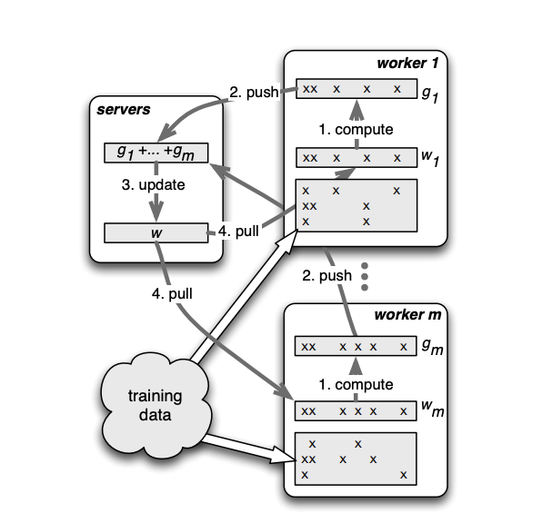




Architecture
Notes:
In the parameter server, each server is responsible for only part of the parameters
Each worker is only assigned to part of the data
here we have a server and we have M workers, in this figure, we have only 2 workers.
W is the working set, these workers have a portion of the training data.
In the first iteration, the workers will pull the working set from the server
It will compute the result inside the worker and then the worker will push the result to the server
The next step is the server will update the working set according to the answers of the workers
Again the workers will pull the working set from the server and do the computation and then push back to the server
And then the server will update the working set again and so on
You can see that the training data is changing through the iterations according to the working set
So this is how the communication between server and workers occurs
Workers get the Assigned training data
Workers Pull the Working set of Model
Iterate until Stop:
Workers Compute Gradients
Workers Push Gradients
Servers Aggregate into current model
Workers Pull updated model

Slide 14
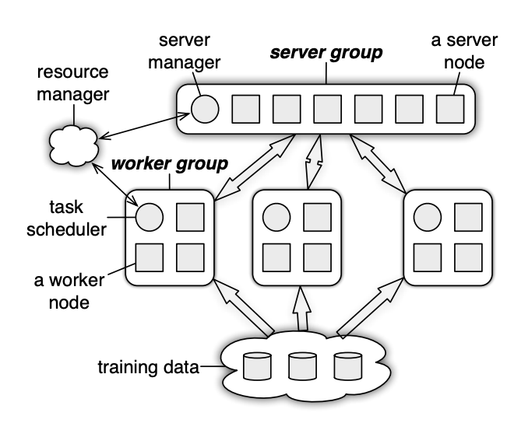
Architecture : the system
The server node
The server manager node
Worker nodes
Task scheduler
Notes:
This is how Communication between servers and workers happen
The server node : each server node can communicate with other server nodes, and each server node is responsible for its own parameters
The server group maintains the update of all the parameters
Then
The server manager node: is responsible for maintaining the consistency of some metadata such as the distribution of parameters
There is no communication between the worker nodes, they only communicate with the server nodes
Worker nodes: only communicating with their corresponding server, not all servers
Each worker group has a Task scheduler: responsible for assigning tasks to workers and monitoring the the workers operations
If a new worker joins or exits , the task scheduler is responsible for reassigning tasks

Slide 15
Architecture: Parameter Key-Value
Model Parameters are represented as Key – Value pairs
Parameter Server approach models the Key-Value pairs as sparse Linear Algebra Objects.
Batch key-value pairs required to compute a vector/matrix instead of sending them one by one
Easy to Program treat the parameters as key-values while presenting them as matrix semantics
Example:
Sparse Linear Algebra Object
(key,value) store
(I₁ , )
(I₂ , )
i₁
i₂
Notes:
In the parameter server, parameters can be represented as key value pair
Where key is the feature ID
And value is the weight
So representing a matrix as a pair k,v is more natural and easy to read and therefore easier to program
Note: for sparse parameter, a key does not exist but it can be considered as 0

Slide 16
Parameter Key-Value : Range Push & Pull
Data is sent between Workers and Servers using PUSH and PULL operations.
Parameter Server optimizes updates communication by using RANGE based PUSH and PULL.
Worker PUSH local gradient
Worker PULLs updated weight back
Let w denote parameters of some model and R is a key Range
w.push(R, dest)
w.pull(R, dest)
These methods will send/receive all existing entries of w with keys in Range
Notes:
Servers and workers communicate with each others by pull and push operations
The workers send the calculated gradient to the server via push and then they update the parameter in the server through pull
In order to increase computation performance and bandwidth efficiency, parameter server allows the use of range push and range pull operation
Assuming that R is the range of the keys that needs to be pushed or pulled.
And W the working set.
If you want to push or pull to destination, you can do so by using these methods

Slide 17
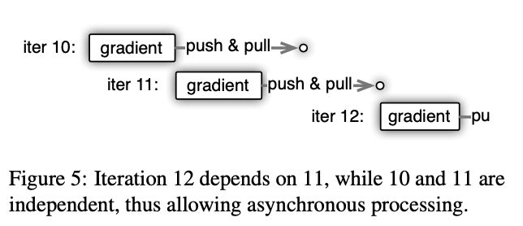
Asynchronous task and dependency
A TASK : push, pull or user defined function
Execute-after-finish dependency
Asynchronous execution
Notes:
User defined function: aggerating data from nodes as they can have more up-to-date information about the shared parameter
Execute-after-finish dependency: helps implement algorithm logic
Asynchronous execution can improve the efficiency of the system because it will save a lot of waiting process
Advantage: saves waiting process
Disadvantage: Easily reduces the convergence rate of the algorithm

Slide 18
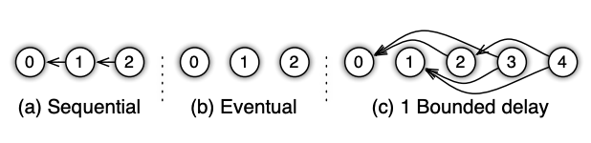
Architecture : Flexible Consistency
3 types of task dependencies
Change the consistency model as per the requirements of the job
The algorithm designer can choose the flexible consistency model
Trade-off between Algorithm Efficiency and System Performance
Notes:
Sequential : this is a synchronous task, one task after the other
Eventual : there is no order between all tasks( opposite of sequential)
Bounded delay : this a trade off between sequential and eventual, where we set a maximum delay time T, and a new task will be blocked until all previous tasks T times ago has been finished
Advantage : more flexible controls
If T 0 sequential
If T infinity then eventual
The flexible consistency consists in the fact that the alg designer can choose the model to use depending on the situation and current needs
Note that the dependency graphs may be dynamic.
For instance the scheduler may increase or decrease the maximal delay according to the runtime progress to balance system efficiency and convergence of the underlying optimization algorithm. In this case the caller traverses the DAG.
If the graph is static, the caller can send all tasks with the DAG to the callee to reduce synchronization cost

Slide 19
Architecture : User Defined Filters
Selectively Synchronize (key, value) pairs.
Allows for fine-grained consistency control within a task
Notes:
The last feature of this architecture is User defined filters
In addition to the scheduler-based flow control, the parameter server supports user defined filters to selectively synchronize individual pairs, allowing fine grained control of data consistency within a task
Filters can be placed at either or both the Server machines and Worker machines.
Example: Significantly modified filter: Only pushes entries that have changed for more than a threshold.
Explain the example in details

Slide 20
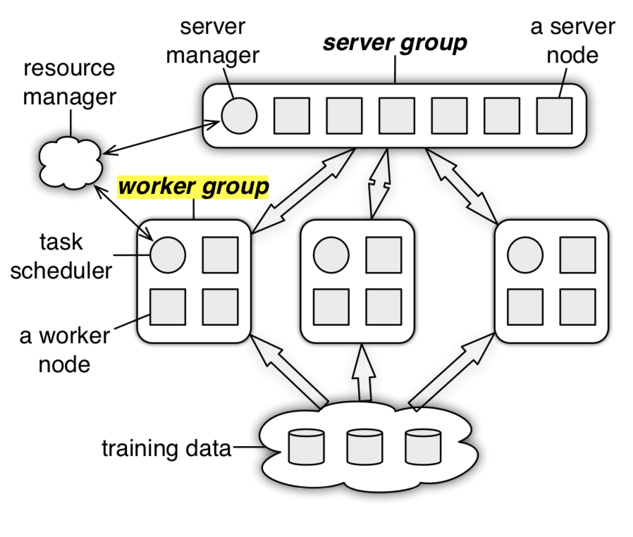
Implementation
Server Manager
Server Nodes
Workers nodes

Slide 21
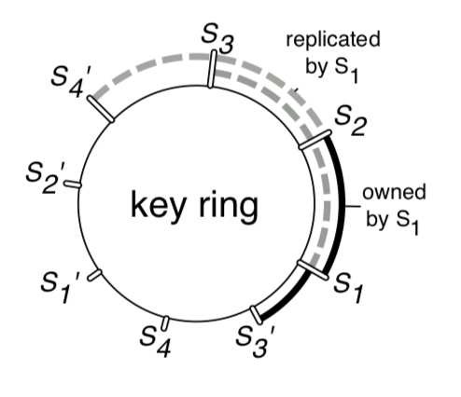
Dividing Parameters
Parameter
There needs to be a way to divide up millions of parameters between servers.
Naïve implementation isn’t scalable…
Servers
Hash Function % # of Servers
Naïve implementation
Consistent Hashing
Used for adding and removing server nodes.
Each server node has multiple virtual nodes
More fined grained distribution
Notes:
Naiive consistent hashing
Giving example
Virtual grained, More fined grained

Slide 22
Server Node addition Protocol
Server Manager assigns Server X
Server X
Server Manager will broadcast this new node change and the servers will delete data if no longer needed.
Server X
Otherwise, server B will no longer accept any requests that are in the range.
If Server X goes down at this stage, then server B will behave normally.
In the meantime, Server X is receiving data from other server nodes
B is going to copy all the Key Values in this range.
Server A
Green region? I’m going to ignore your request
Server Manager
Server B
Hey Server B, let me push some of my computations into the green region…
Server D
Worker
Server C
Notes:
Point out server C’s responsibilities, etc

Slide 23
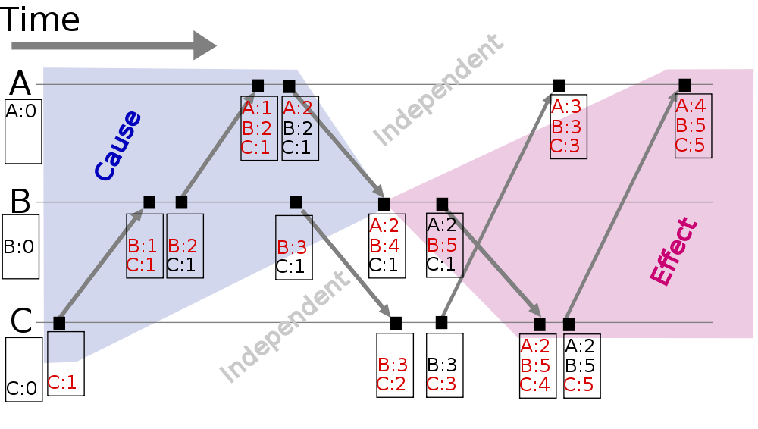
Vector clocks
Vector clocks are used for fast recovery and rejecting doubly sent data.
Allows the server to determine some ordering of events in the system
records timestamps for every message.
Notes:
It forces a singular defined ordering

Slide 24
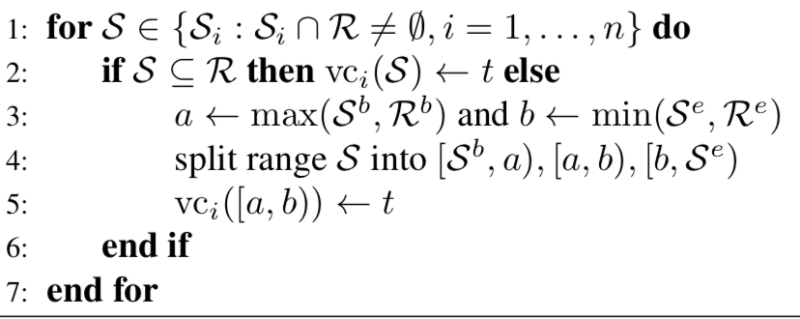
Vector clock
Stored by ranges, not every parameter value
Saves space
O(mp) vs O(mr)
P is the # of parameters, r is the # of ranges.

Slide 25
Messages
Worker nodes and Server nodes exchange messages with each other.
A message consists of:
Vector Clock
Key-Value pairs within the range
Optimizations
Snappy compression
Receiver caches the key lists

Slide 26
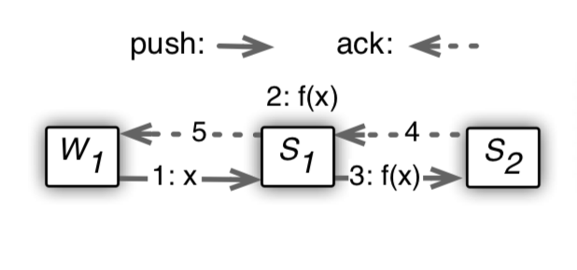
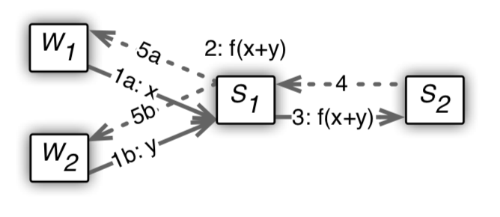
Replication and Consistency
K-replication
Stores replica in k counterclockwise nodes
Replication happens for push and pull after aggregation is completed.
Lowers bandwidth usage.

Slide 27
Worker Management
To add a new worker node:
Task scheduler assigns a task to a worker
Node loads data
Broadcasts this to other nodes

Slide 28
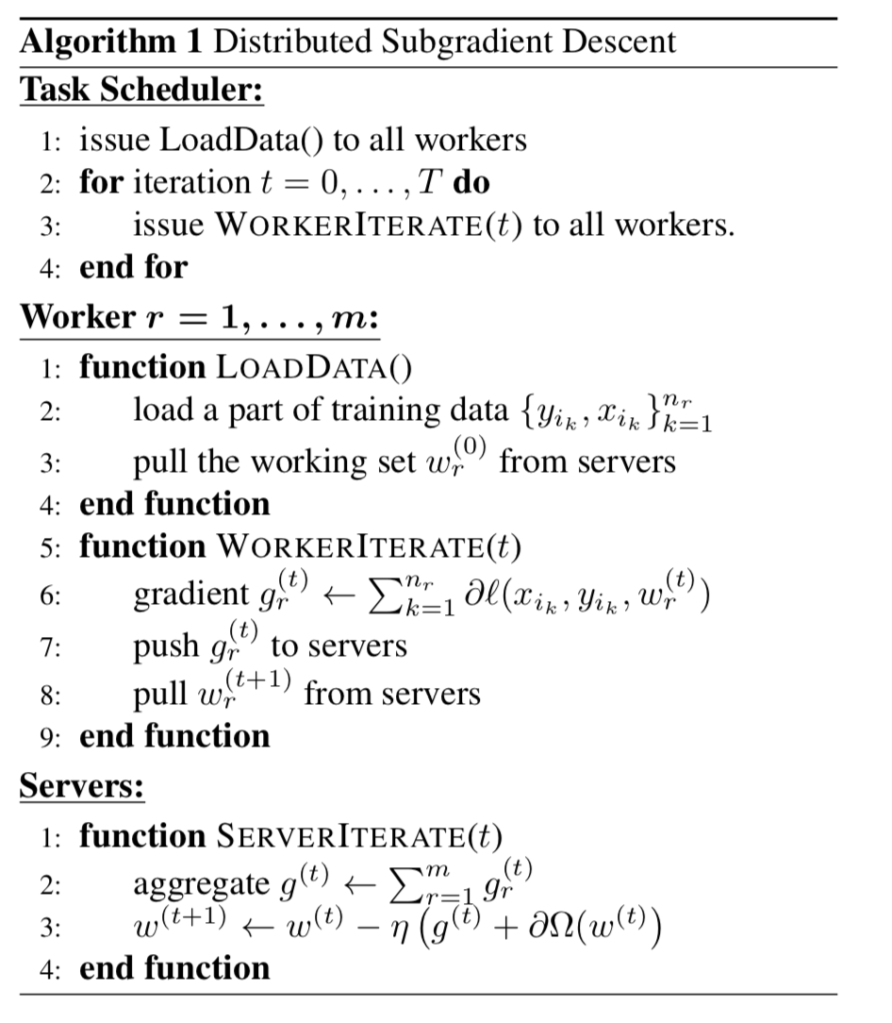
Example

Slide 29
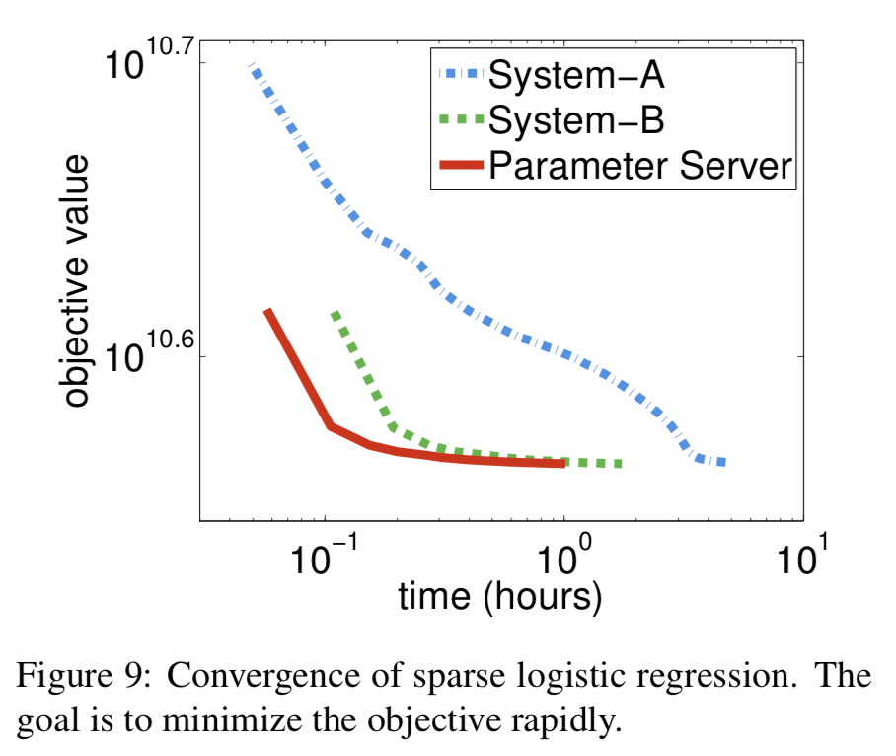
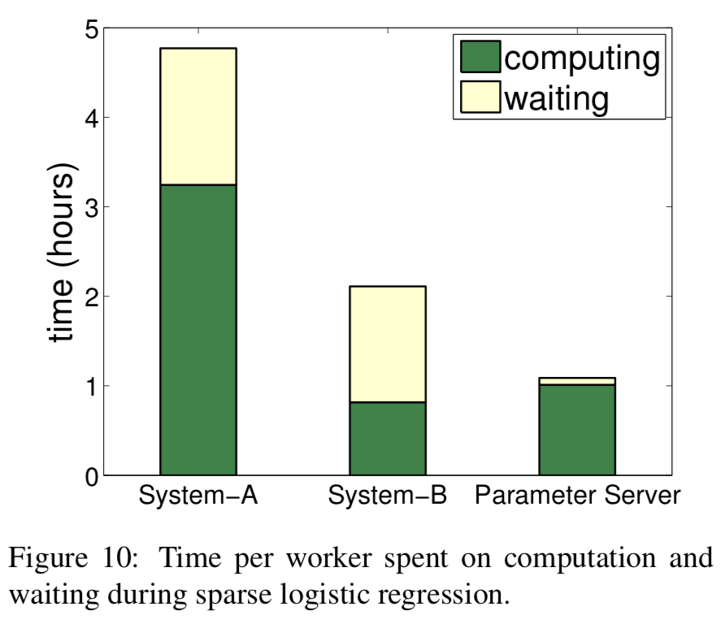
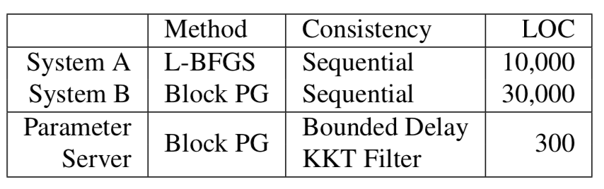
Results
Notes:
Used adclick prediction data
The parameter server is able to achieve these results in 4 main reasons:
Blocks of parameters are updated in each iteration
Workers compute both the gradient and the diagonal part of the block
Parameter servers updates the model by solving the proximal operator based on local gradient
KKT filter to suppress chances that won’t affect the model

Slide 30
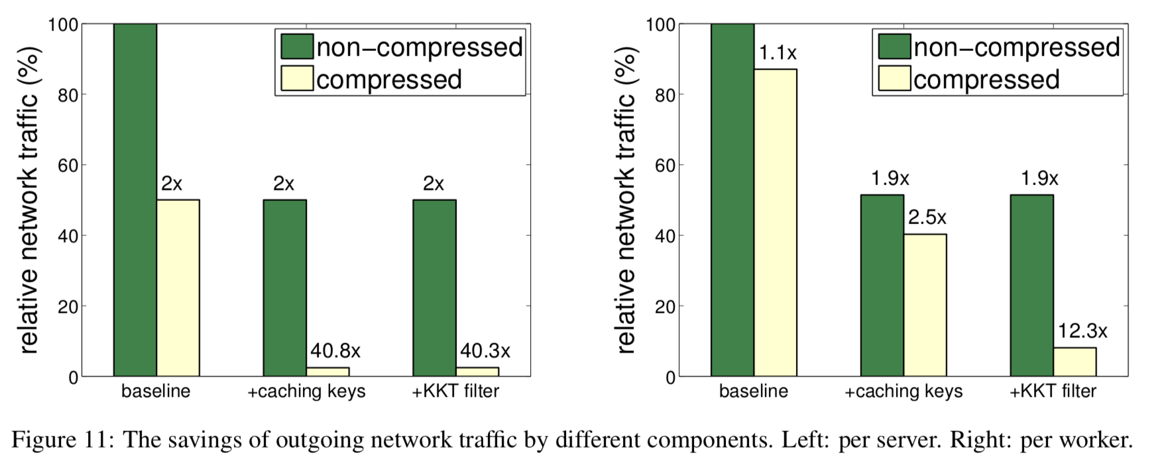
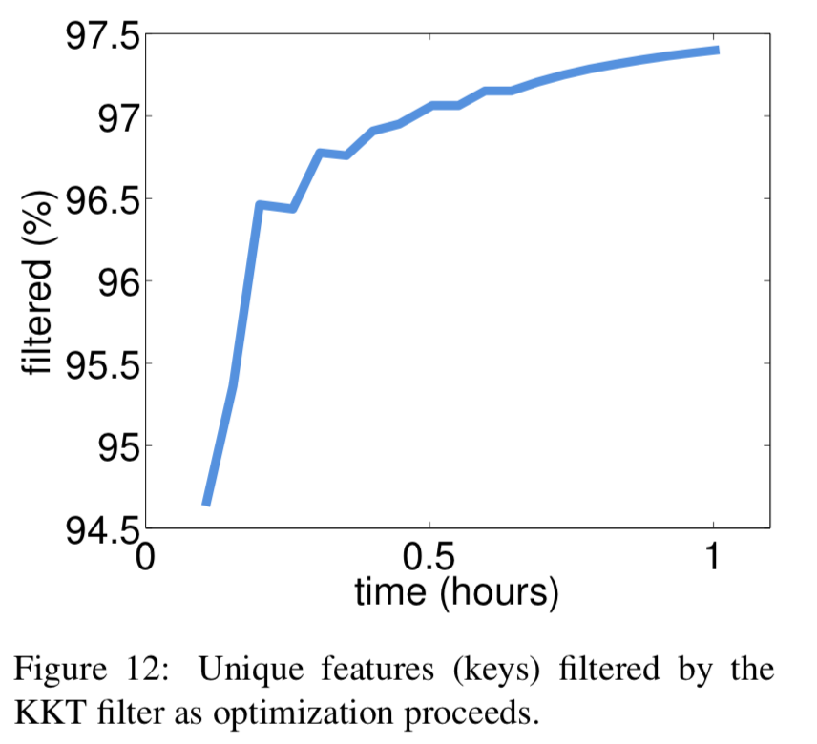
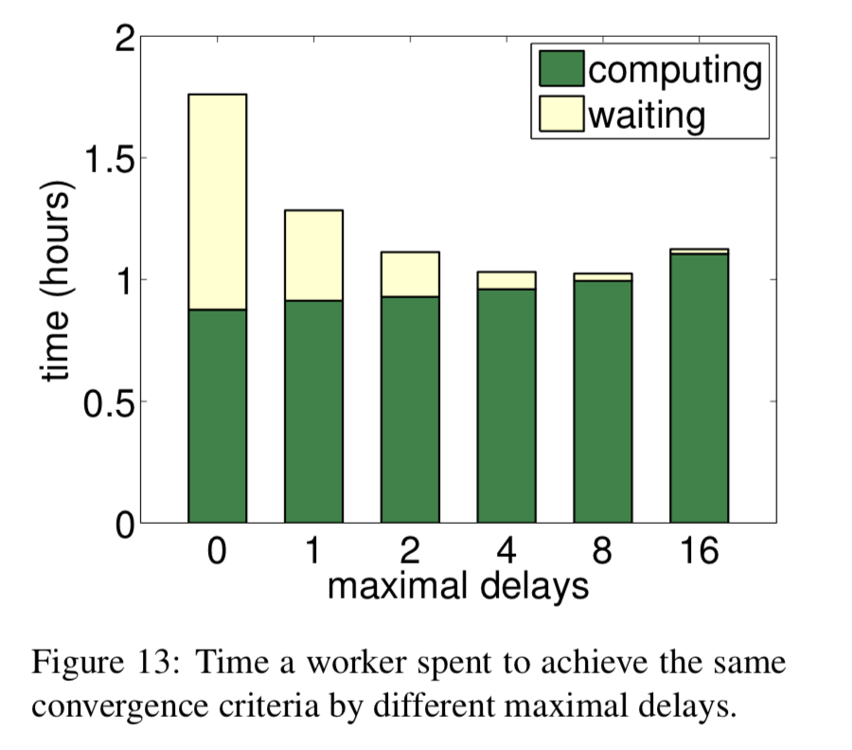
Results

Slide 31
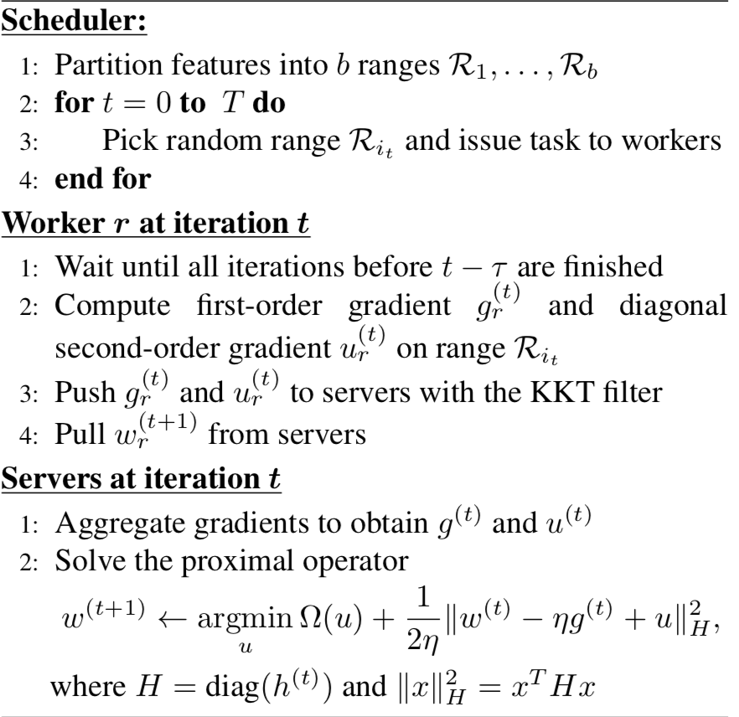
Algorithm

Slide 32
Summary: Pros
Efficient Communication:
Batching (key,value) pairs in Linear Algebra objects
Filters to reduce unnecessary communication & message compression
Caching keys at worker and server nodes for local access
Flexible Consistency Models:
Can choose between Sequential, Eventual, and Bounded delay consistency models
Allows for tradeoffs between System Performance and Algorithmic Convergence
Fault Tolerance and Durability:
Replication of data in Servers
Failed workers can restart at the point of failure by using vector clocks
Ease of Use:
Linear Algebra objects allow for intuitive implementation of tasks

Slide 33
Summary: Cons & Further Discussion
What are System A and System B? What is the design differences.
Server Manager Failures and Task Scheduler failures not discussed.
Experiments on the other two systems with Bounded delay model.

Slide 34
STRADS: A Distributed Framework for Scheduled Model Parallel Machine Learning

Slide 35
10,000 ft. View
Scheduled Model Programming (SchMP) improves convergence speed of model parallel ML by scheduling parameter updates
Parameter dependencies
Uneven convergence
STRADS is a distributed framework that optimizes throughput of SchMP programs
SchMP improves "progress per iteration" while STRADS improves "iterations per second" (throughput), so together they improve "progress per second" to converge quickly
Notes:
Add more deltails about how things work
Who assigns

Slide 36
Machine Learning 101
In each iteration, parameters are used to make some prediction on a subset of training data
This prediction can be used to estimate the necessary parameter changes for the correct prediction to have been made on this data
By gradually changing tweaking parameters based on small subsets, can reach a solution for entire training dataset
Convergence is what happens as parameters get closer to some local ideal on training data
Parameter updates have unpredictable effects on progress towards convergence
Efficiency described in number of iterations to converge
We want to increase progress (aka decrease in loss) per iteration

Slide 37
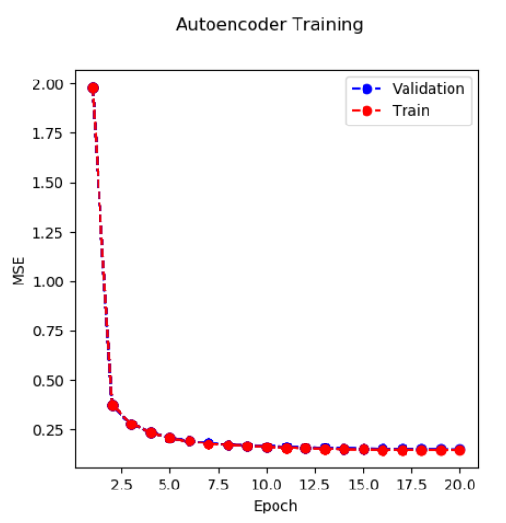
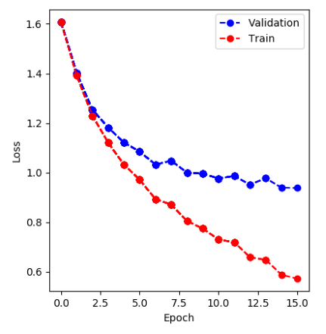
Machine Learning 101
Efficiency described in number of iterations to converge
We want to increase progress (aka decrease in loss/error) per iteration

Slide 38
Model Parallelism
Data parallelism: A model small enough to be run on a single machine is trained in parallel with different subsets of data
e.g. MapReduce
Model parallelism: A large model with many parameters must be run across a cluster. Each machine updates a portion of parameters
Each worker task can be trained with the full training data or a subset

Slide 39
Data Parallelism
Data D
Data subsets D1, D2, …, Dn
D1
P
P’1
Model Parameters P
D
D2
P
P’2
P’
A model small enough to be run on a single machine is trained in parallel with different subsets of data
Dn
P
P’n

Slide 40
Model Parallelism
Data D
Model Parameters P -> Subsets P1, P2, …, Pn
D1
P1
P1’
D
D2
P2
P2’
A large model with many parameters must be run across a cluster. Each machine updates a portion of parameters
Dn
P3
Pn’

Slide 41
Model Parallelism
Parameter updates must be periodically communicated to dependent parameters on a separate worker
Some parameters may take more iterations to converge
In a naïve system, a parameter that takes 10 iterations to converge and depends on a parameter that takes 100 iterations would block

Slide 42
Model Parallelism
An ideal parallel schedule would maximize progress per iteration
Would likely incur acceptable errors by violating dependencies
Computationally inefficient to compute
A random schedule would fail or progress slowly
An approximate schedule can be cheaply computed
Based on the SchMP model, this may be statically or dynamically computed

Slide 43
Previous systems
Tolerable errors and relaxed synchronization
Lacked fine-grained control of parameter updates, so can't handle model parallelism’s parameter dependencies or uneven convergence
Schedule is computed by workers alongside parameter updates

Slide 44
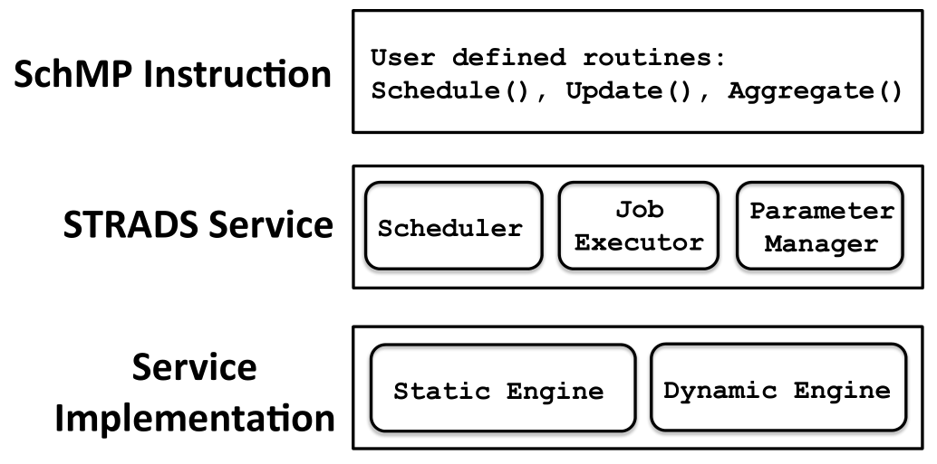
STRADS
System to execute SchMP programs
Automatically optimize throughput (iterations per second)
Three layers
User-level SchMP Instructions
Services to run SchMP Instructions on a cluster
Service implementation on Static Engine and Dynamic Engine

Slide 45
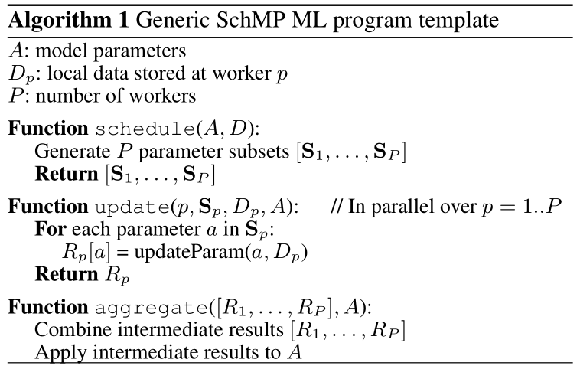
SchMP Instructions on STRADS
SchMP Instructions are user defined abstract functions
Performed iteratively by STRADS
First, schedule( )
Next, parallel update( ) instances
Finally, aggregate( )

Slide 46
STRADS Services
Execute SchMP Instructions across a cluster
The Scheduler computes schedule( ) and distributes jobs
May be implemented in parallel or pipeline scheduling
Stateful across iterations
Performs aggregate( ) and update parameters in Parameter Manager
The Parameter Manager provides global access to parameters
Implemented separately for Static Engine and Dynamic Engine
The Job Executers run update( ) processes
May also be stateful across iterations

Slide 47
Scheduling optimizations for SchMP
Pipelining allows dependent parameters to update( ) using parameter values from some previous iteration
s-deep pipeline allows a model to run iteration i with dependent parameters from iteration i-s
Stale data slows progress per iteration
Not blocking for up-to-date parameters increases iterations per second
Prioritization estimates, based on simple heuristics, which parameter updates will facilitate the greatest progress
High potential for increased progress per iteration of the system

Slide 48
Service Implementations (Engines)
Dynamic schedules change on the fly
Ideally, dynamic schedules should perform more fine-grained updates to parameters
In conjunction with exploiting uneven parameter convergence, can identify optimizations quicker, so less computation is wasted
However, with shorter iterations for workers, latency from the scheduler and networking between computers increases
These tradeoffs aren’t important in static schedules, so two engines are implanted – Static and Dynamic

Slide 49
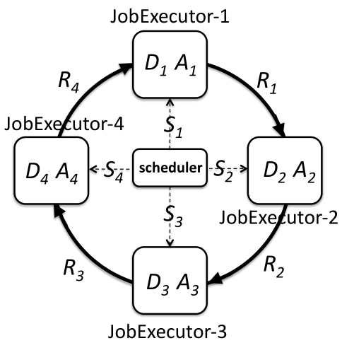
Static Engine
Doesn’t have the same need for small parameter update, so updates to Parameter Manager cause sporadic jumps in bandwidth use
Job Executers are interconnected by the Parameter Manager in a ring to transfer parameters and intermediate results
As parameter updates and intermediate results are passed in a ring, Job Executers take the data they need and pass everything along.

Slide 50
Dynamic Engine
With short iterations/fine-grained parameter updates, network delays are significant relative to computation time
To increase computational utilization, pipeline is used to overlap computation on top of network communication
Pipelining overall increases throughput, but gives it a slight decrease due to using old model parameters
At scale or with very fine-grained parameter updates, scheduling latency can be a bottleneck. In this case, scheduling can be distributed

Slide 51
Other considerations
STRADS achieves fault tolerance by checkpointing model parameters after set number of iterations
STRADS avoids locking by not sharing data structures between threads in the same process
In a Dynamic iteration with pipelining, the highest priority parameters are updated first so that other updates ahead in the pipeline can use these sooner

Slide 52
Analysis - Static-scheduled SchMP on STRADS
Compared with data parallel implementations
Static SchMP scheduling has high progress per iteration
Static SchMP scheduling has high throughput
Efficient synchronization with Job Executors ring topology
Maintains at scale while other systems drop off at 50 to 100 machines
Avoids lock contention within processes
Converges 10 times faster

Slide 53
Analysis – Dynamic-scheduled SchMP on STRADS
Decreased the number of data samples required for convergence by an order of magnitude
Convergence time decreases largely because of prioritization based on dependencies
Dynamic SchMP pipelining improves throughput enough to offset loss to progress per iteration
Compared to implementation on Spark, converged to better result in 3 minutes rather than an hour
Converges 5 times faster
Implemented in 100s LOC

Slide 54
Conclussion
SchMP implemented ML achieves high progress per iteration
SchMP programs on STRADS achieve high throughput
Using a whole new paradigm, SchMP, for writing ML algorithms requires a lot of work from users
schedule( ) must currently be implemented by users
Authors suggest an interesting area of research is hybridization of model parallel and data parallel models

Slide 55
Discussion
Parameter Server : is the flexible consistency a benefit?
What are the benefits for ring topology in Static Engine?
Reduce load on Parameter Manager?
Are there possible optimizations for STRADS checkpointing?
Why did dynamically-scheduled STRADS decrease the amount of data needed for convergence?
Does anyone know of work on combining model and data parallelism?

